Slide 1
Today’s Multicultural, Bilingual, & Diverse Schools
SPED 326
Fall 2014

Slide 2
Agenda
Quiz
Objectives & Conceptual framework
The Danger of A Single Story
Student Profiles & Single Stories
Culturally Responsive Education
Fishbowl Activity
Looking Ahead

Slide 3
Objectives
By the end of this session, you will …
Consider how your own culture, norms and values impact your interactions with diverse students and families
Identify specific skills and strategies for culturally responsive teaching
Discuss the challenges and importance of advocating for students from diverse backgrounds as a teacher.

Slide 4
Conceptual Framework
PST will gain an appreciation for difference and the skills to create an equitable environment in their general education classroom.
PST will be able to:
(a) locate and identify evidence-based resources even if they are not available in their school
(b) use tools and resources to increase accessibility in the general education classroom for specific disability categories
PST will be able to:
(a) read and interpret an IEP
(b) identify portions of the IEP that are applicable to their practice
(c) use data to make pedagogical decisions around disability
(d) implement the IEP in a general education lesson plan
PST will be able to:
(a) write a lesson using an end of year portfolio template
(b) incorporate Universal Design for Learning and differentiated instruction in their lesson planning
PST will have:
(a) an understanding of the foundations of disability law
(b) an understanding of the disability law's impact on the profession and interactions with families
(c) an awareness of student and family needs in IEP development and implementation

Slide 5
Quiz
Which theory describes perceived inherent disadvantages within students’ specific cultural backgrounds?
Theory of cultural difference
Genetic deficit theory
Cultural reproduction theory
Cultural deficit theory
According to your text, which race/ethnicity is most likely to spend time outside the general education setting?
American Indian/Alaska Native
Black
Hispanic
Asian/Pacific Islander

Slide 6
Quiz cont.
By taking an ecological perspective, culturally responsive educators can:
Understand the powerful influence of factors at multiple “layers” that impact a student and align with race, language, and poverty.
Identify and proactively address the barriers at multiple levels to support positive student outcomes.
Advocate for systems change.
A and B
All of the above
Which of the following is NOT a strategy of culturally responsive teaching?
Teachers self reflect on their own cultural identity.
Learning instructional strategies that support African American students and implementing these methods with all African American students.
Teachers get involved in the greater community outside their school.
Implementing the adapted posture of cultural reciprocity.

Slide 7
Quiz cont.
According to your text, a dual language learner who speaks Spanish at home may:
Be at risk for mis-identification in special education
Celebrate Cinco de Mayo
Go through a silent period for 12-18 months
All of the above
A and C

Slide 8
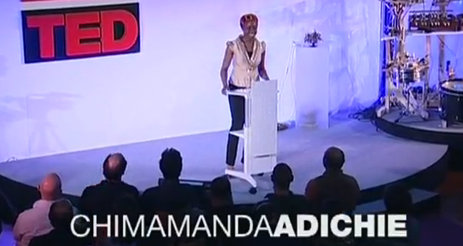
The Danger of a Single Story
Think-Pair-Share
Reflect on Chimamanda’s story.
When have you viewed a person based on a single story. What happened? What is the danger of single stories in the school context?

Slide 9
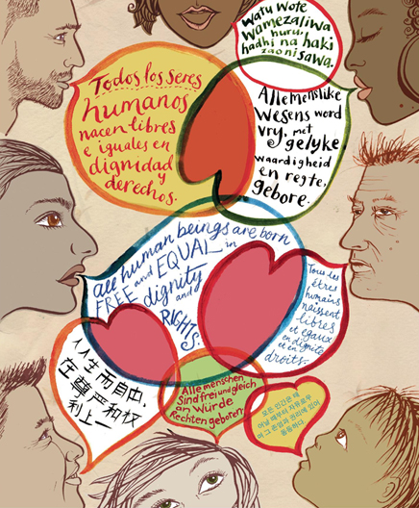
Single Stories of Students?
Form groups based on the student profile handout
Discuss prompts (1 person record)
In what ways might you as a teacher advocate for a more culturally responsive view in order to help this student be successful?

Slide 10
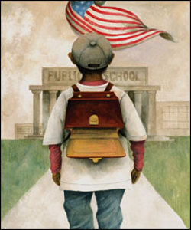
Why talk about culture?
Image of the students
Culture influences what adults assume about children and want for children.
Theory of learning
Culture influences how children approach learning.

Slide 11
Being Culturally Responsive
With your animal group, complete the graphic organizer about your video:
Katy LaCroix (Dolphins)
Darnell Fine (Frogs)
Christopher Hoeh (Monkeys)
Amy Vatne Bintliff (Roosters)
Laurence Tan (Snakes)
Anna Baldwin (Wolves)
We will upload your completed graphic organizers to Blackboard to share strategies – so be specific!

Slide 12
Fishbowl
Make a circle around the perimeter of the room with the chairs.
Make a smaller circle of 5 chairs in the middle of the room.
Only the 5 people in the middle can speak.
One person from each group must be represented at all times.
Group members on the outside of the circle can tag “in,” but wait until their group representative has made a substantial contribution
Keep discussion focused on what you learned from the textbook and supplemental readings.
Outer circle may pose questions to the inner circle.

Slide 13
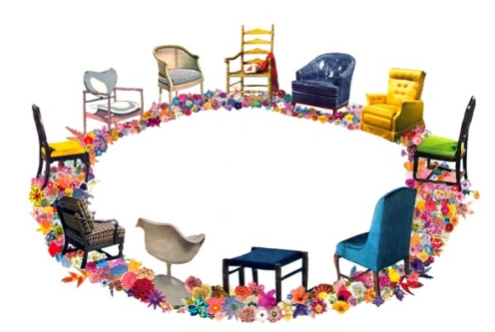
Fishbowl
First topic: What are the problems in education and specifically special education around culturally and linguistic diversity?
Second topic: What are some strategies that you learned to help you be a culturally responsive teacher?

Slide 14
Closure
In what ways do power and privilege create inequitable educational opportunities and outcomes for students from diverse backgrounds?
What does this make you think about your role and responsibilities as a future educator?

Slide 15
Looking Ahead…
Next class: Partnerships with Families
Read Chapter 4
Application Assignment

